Slide 1

Data Warehouse Project
By MD Hossain, Rajiv Dhakal, Komal Gautam, and Obioma Nduka
Notes:
Sakhawat

Slide 2

Content
Introduction and project goals
Features overview
Implementation and testing
Outlook and general feedback
Conclusion
Notes:
Sakhawat

Slide 3
Introduction
Project Goal: Design and implement a local Admin Dashboard to manage:
Sensor data
Video uploads
Storage usage
Tech Stack:
Backend: FastAPI (Python)
Database: SQLite
Frontend: HTML, CSS, JavaScript
Visualization: Chart.js
Purpose: Provide an interactive and modular system for future AI/data projects
Notes:
Sakhawat

Slide 4



Tools Used
to write the code.
To keep code and data synchronized
To chat with each other via video calls or exchange ideas.
Notes:
Komal

Slide 5
Admin Dashboard Features Overview
1. User Interaction
Users can easily enter and manage sensor data through an intuitive interface.
2. Video Management
Seamlessly upload and preview videos within the dashboard for immediate access.
3. Data Organization
Efficiently categorize sensor data and video files for quick retrieval.
4. User Accessibility
Designed for user-friendliness, the interface promotes effective data interaction.

Slide 6
System Architecture
FastAPI handles API requests
SQLite stores sensor data and video metadata
Frontend (HTML/JS/CSS + Chart.js) renders the Admin Dashboard
Clear separation between backend, storage, and user interface

Slide 7
Key features
Sensor data submission and deletion, analysis data by dynamic line chart
Video upload and preview in-browser
Storage usage tracking with live updates
Export ML-ready dataset from selected time intervals

Slide 8
Implementation Highlights
Structured folder layout separating API, UI, and storage
Live rendering of charts with dynamic updates
Efficient form handling and validation
Accurate storage usage calculation logic

Slide 9
Challenges & Solutions
Secure file handling: Prevented invalid file types and sizes
Chart issues: Fixed duplicate canvas bugs
UI layout spacing: Reduced vertical gaps for compact design
Debugging storage: Matched logic with FastAPI logs

Slide 10

Outlook into the future
- Deploy permanently to cloud (e.g., Vercel, Render)
- Add user authentication
- Enable chart export (PDF/PNG)
- Add historical storage tracking
- Integrate with external sensor APIs
Notes:
Ovi

Slide 11
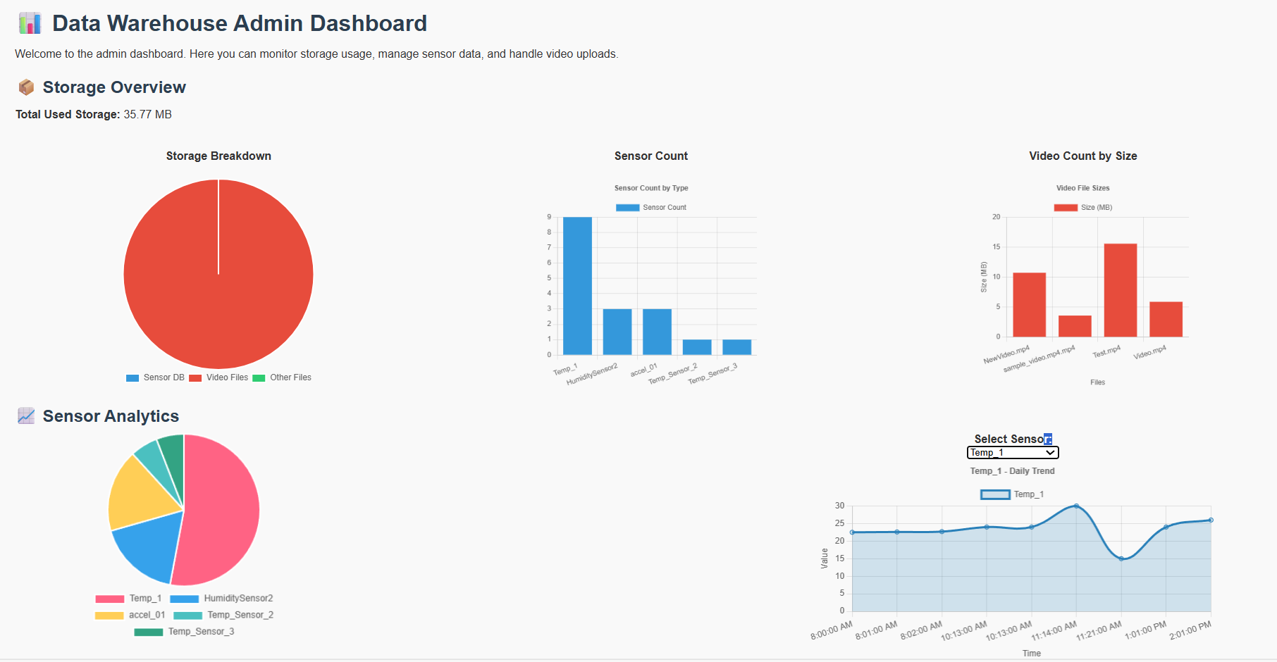
Live demo:
Data Warehouse:
Notes:
Sakhawat

Slide 12
Conclusion
Successfully built a modular, local Admin Dashboard for sensor and video data
Emphasized usability, clean architecture, and ML-readiness
Lays foundation for future student and AI projects
Personally gained skills in full-stack development, debugging, and deployment readiness
Notes:
Ovi

